Slide 1
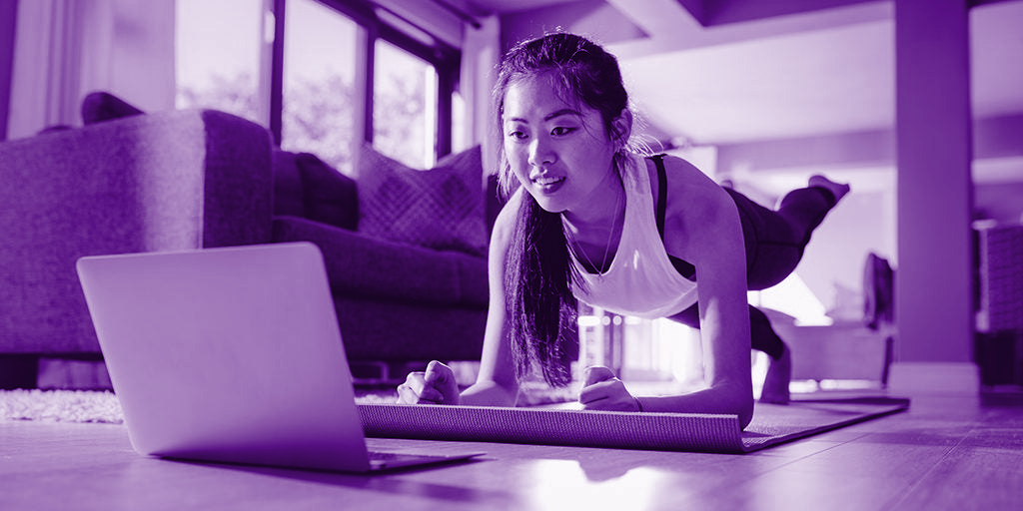

Capstone Project
24th December, 2020
David
Ronald
Eddy
Group Members :

Slide 2
01
Business Values
OpenPose
02
AGENDA
03
05
Action Recognition models
Deployment
Counting Recognition model
04
06
Demo
07
Challenges & Further Improvement

Slide 3
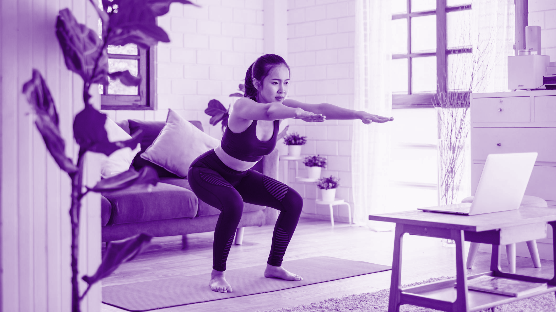
01
Business Values

Slide 4
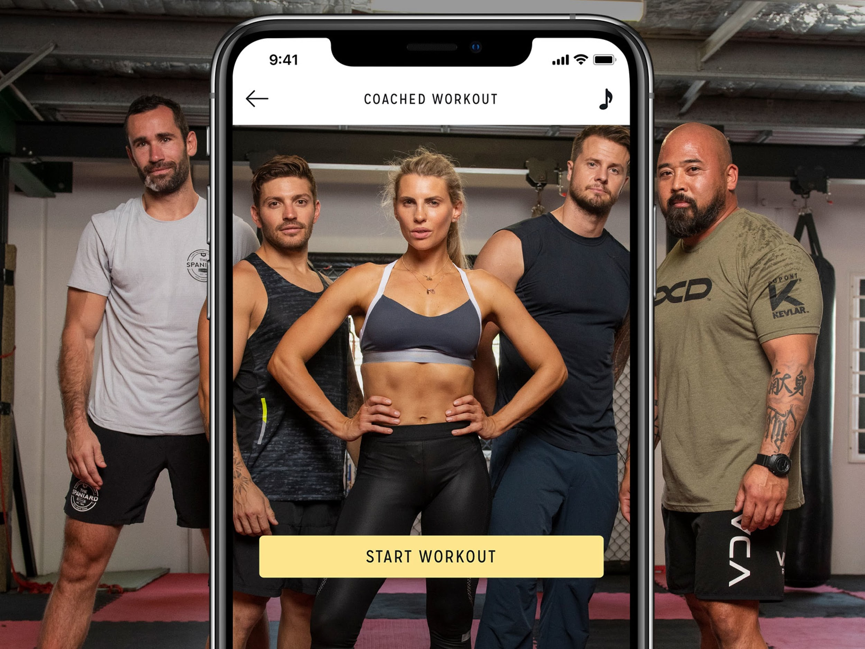
Business Values
“Worldwide fitness app market size is predicted to reach USD 15.96 billion mark by 2026. Rising concerns associated with unhealthy habits, evolving consumer lifestyle, and growing obese population are some of the key factors propelling the market expansion.”
(24 Nov. 2020 Market Study Report, LLC.)

Slide 5
Your Personal Trainer 24/7
*Real time detection
*Feedback for correctness of form
*Timing
*Counting
Allow users to work out anytime and anywhere, with personalized counting and timing for exercises, and feedback for form correctness.

Slide 6
Model architectures
Processing skeleton feature
Action detection models
OPEN POSE
Training and testing with sklearn MLP models
Pose Estimation
( getting raw skeleton coordinates )
Workouts detection
Counting detection model
Seperating and counting each action with CNN model (with optical flow algorithm)

Slide 7
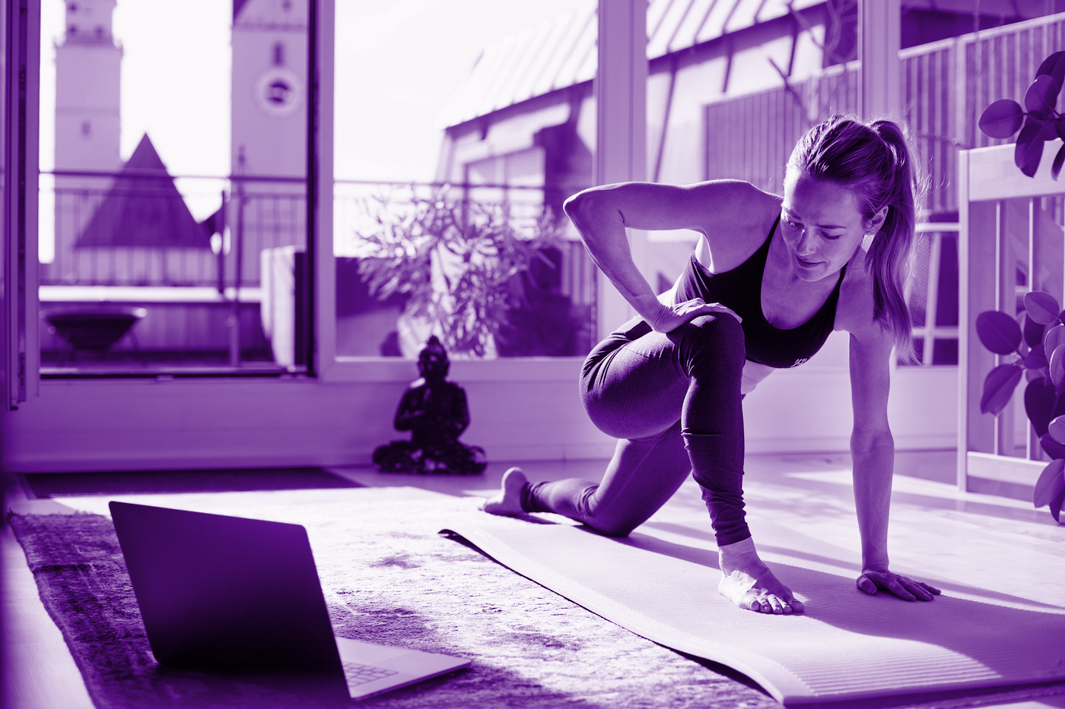
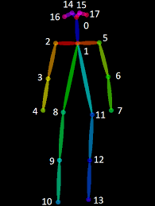
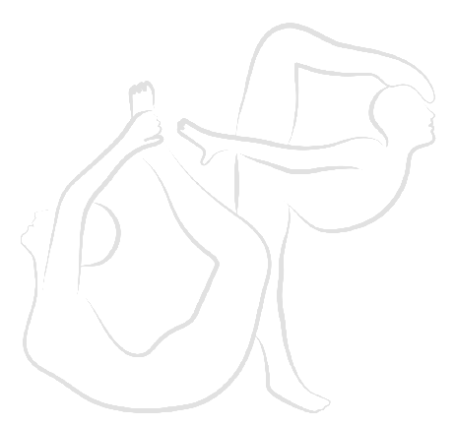
02
OpenPose
Notes:
I will then talk about the openpose model

Slide 8
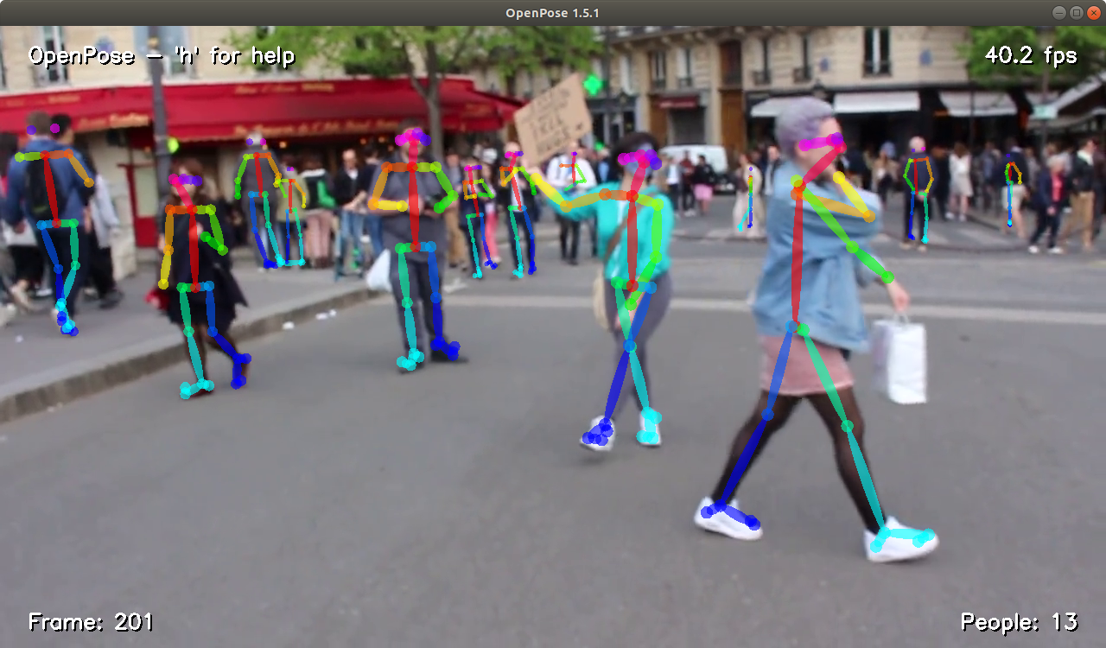
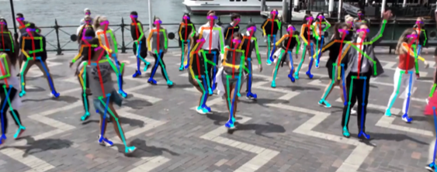
Openpose
The first real-time multi-person system to jointly detect human body, hand, facial, and foot keypoints (in total 135 keypoints) on single images.
Notes:
Openpose is the first real-time multi-person system to jointly detect human body, hand, facial, and foot keypoints on single images. It is widely used for pose estimation, and also action recognition, which is what trAIner24 is going to do, recognizing correct and incorrect forms of workout.

Slide 9
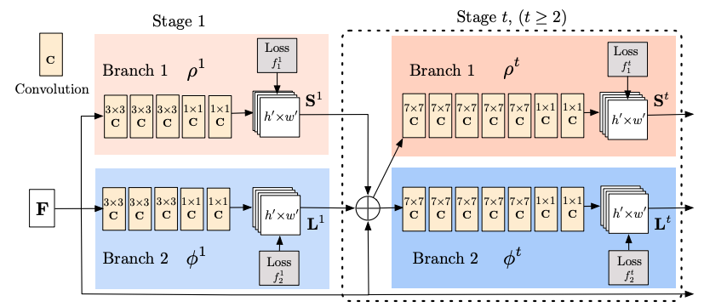
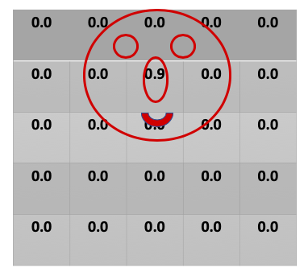
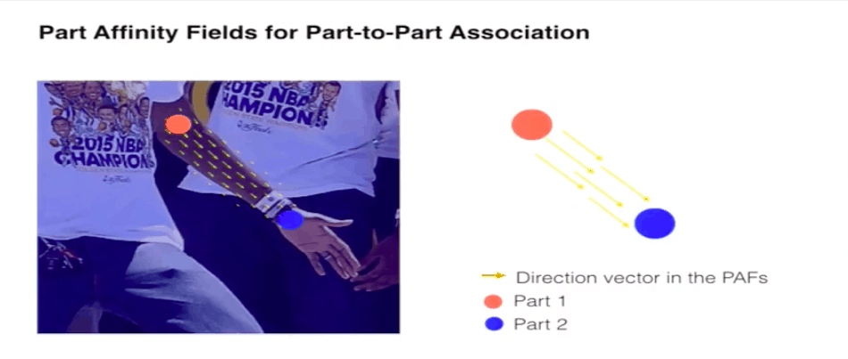
“Two-branch multi-stage” CNN
Confidence Maps
Affinity Fields
Notes:
As for the operation of openpose, firstly, an RGB image is fed as input into a “two-branch multi-stage” CNN. Two branch means that the CNN produces two different outputs (and multi-stage simply means that the network is stacked one on the other at every stage).
The top branch, predicts the confidence maps of different body parts location such as the knees, elbows and others. The bottom branch predicts the affinity fields, which represent a degree of association between different body parts.
As for multi-stage, the predictions in the previous stage, along with the original image features, are concatenated in each subsequent stage to produce more refined predictions.
#And for the model we used, the final stage is chosen to be 7.
Finally, the confidence maps and affinity fields are being processed to output the 2D key points for all people in the image.

Slide 10
03
Action Recognition Models
Notes:
I will then talk about the action recognition model and the inference process.

Slide 11
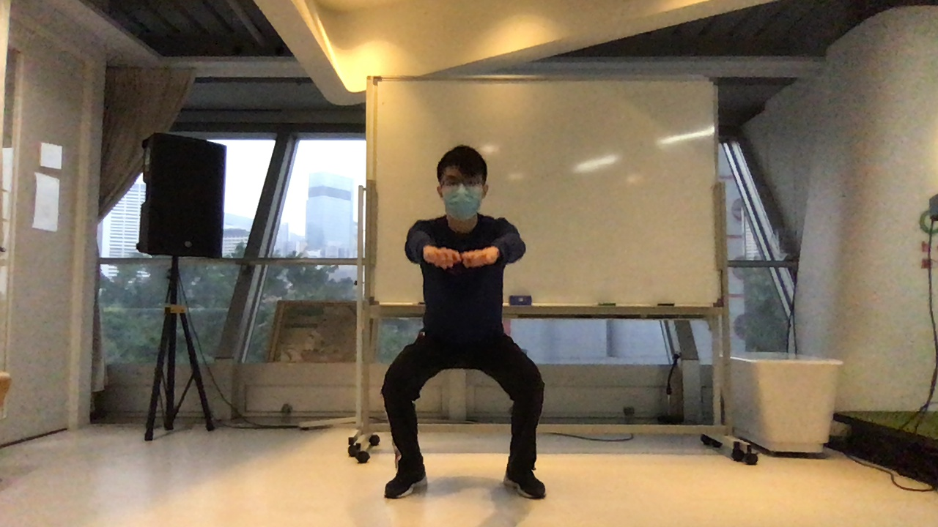
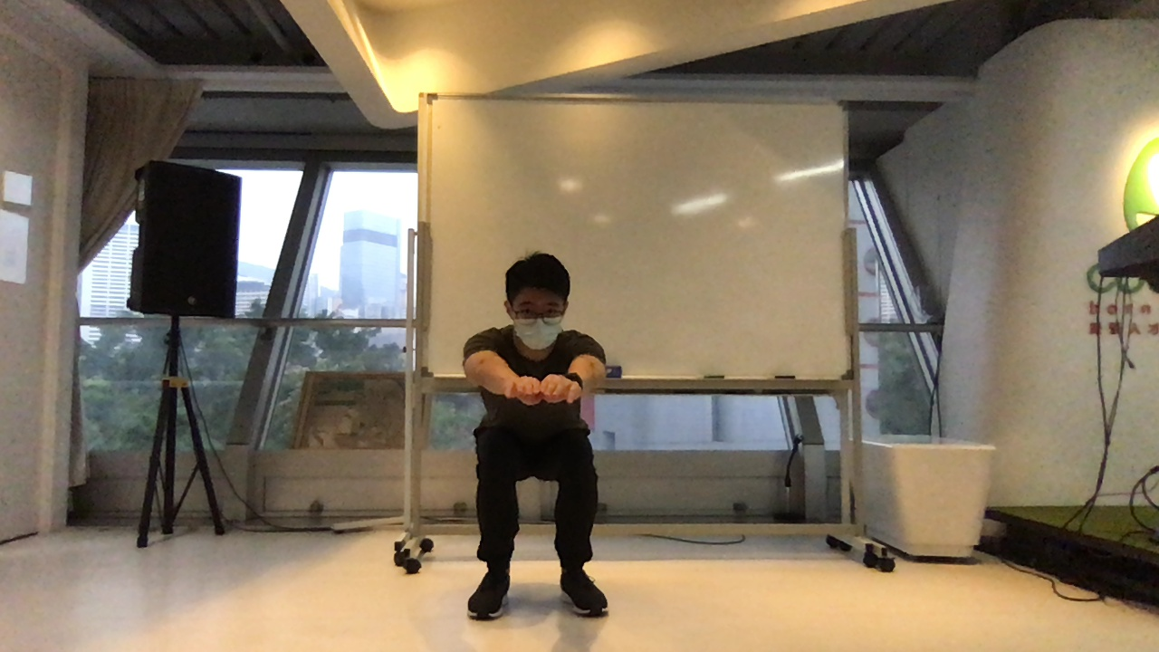
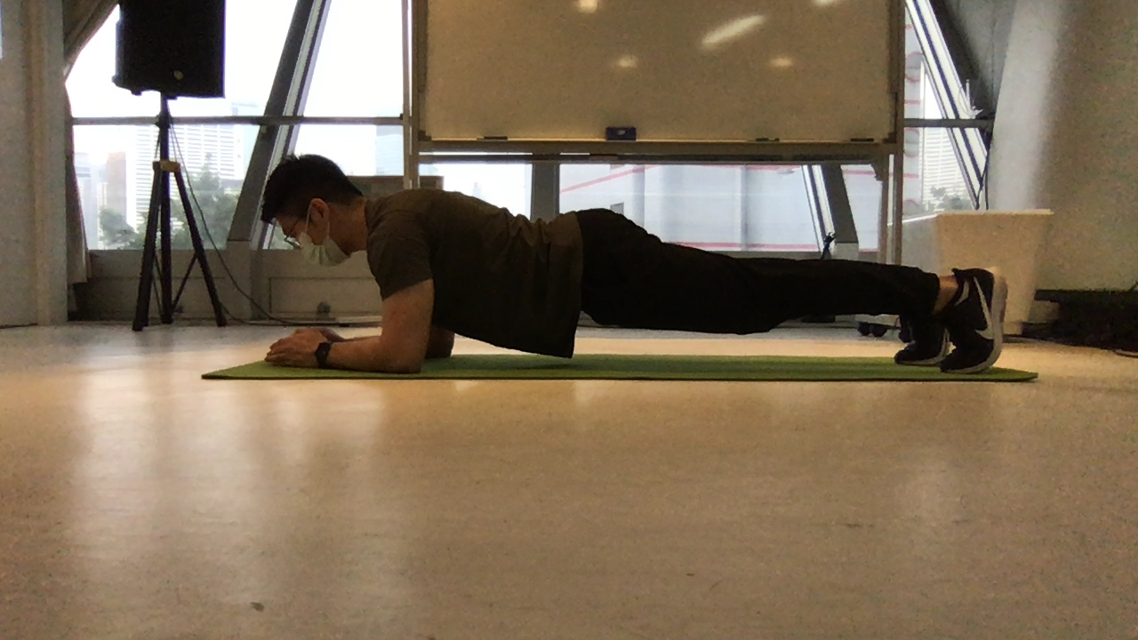
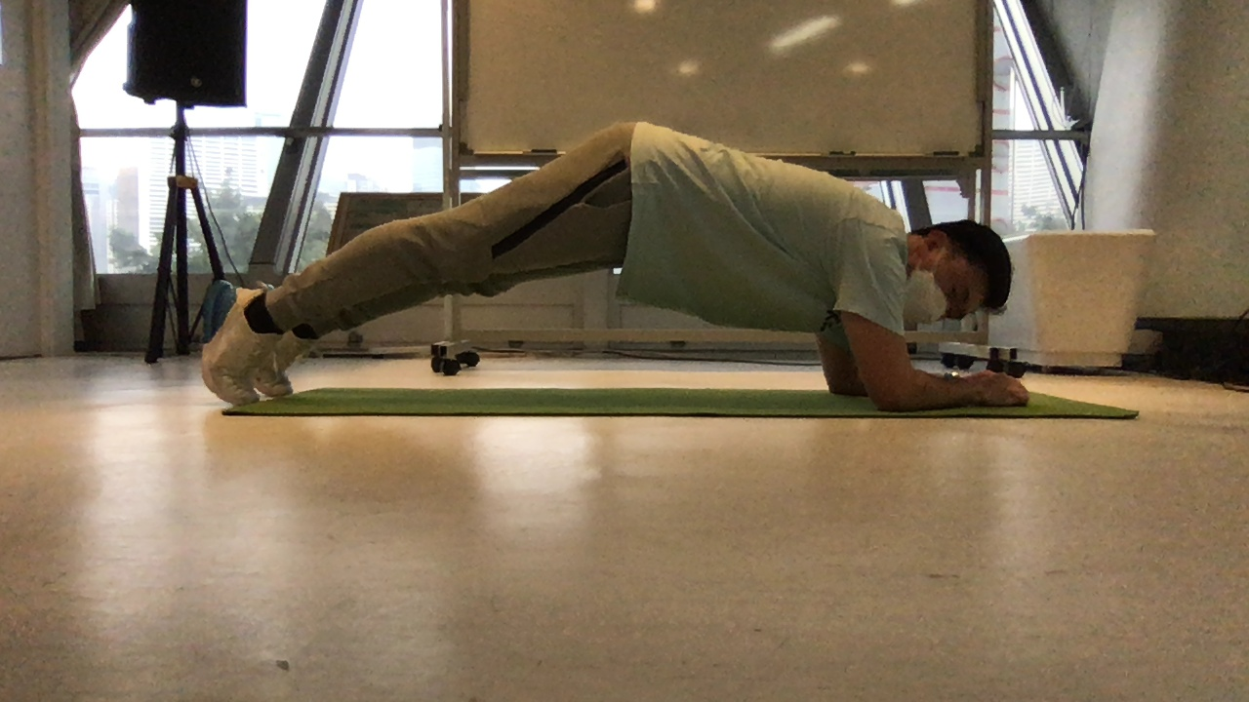
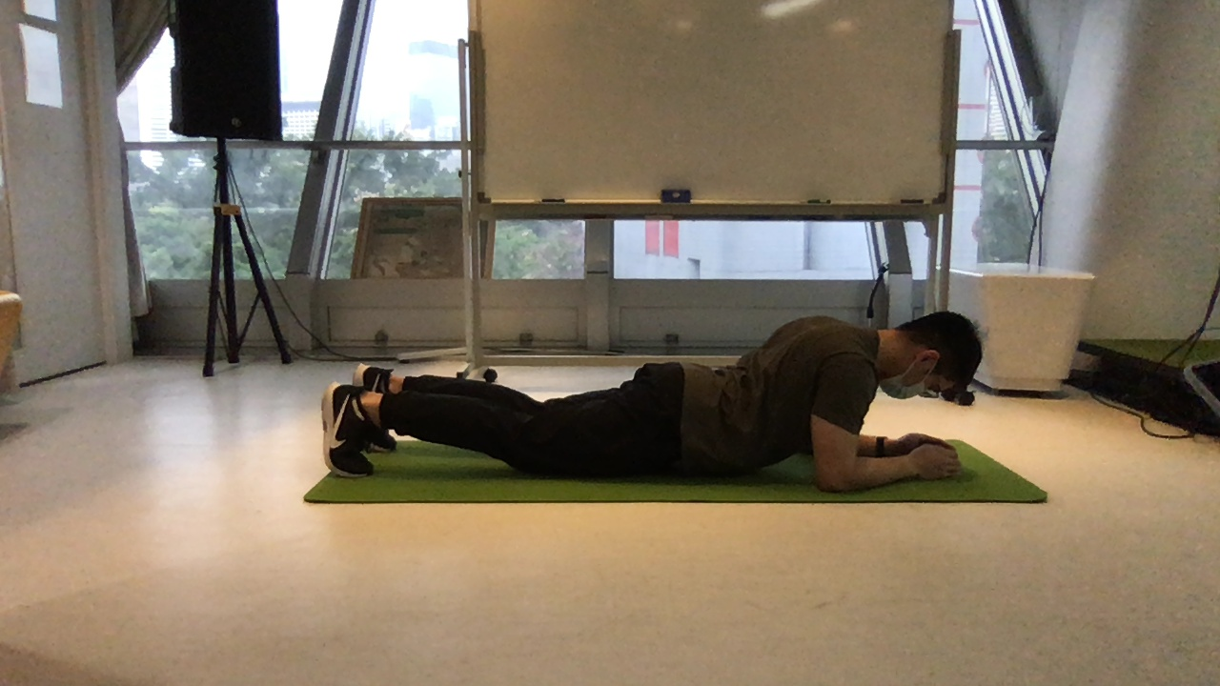
Data (Action Recognition Models)
1330
2659
1329
1736
5611
1785
2090
Correct
Squat
Incorrect
Correct
Plank
Incorrect (High-Hip)
Incorrect (Low-Hip)
Notes:
We trained our own action recognition models, one for squat and one for plank. For the data, we tried our best and took several videos for squat and plank, and then changed them into images as data input. There are in total 2659 images for squat. And for plank, there are 5611 images
Squat:
2659
Raw feature length: 36
Number of classes=2
After preprocessing: x.shape = (2299,314), len(y)=2299
Plank:
Raw feature length: 36
Number of classes=3
After preprocessing: x.shape = (5531,314), len(y)=5531

Slide 12
Output the label and skeleton to the output frame
Read the input frame
Get the key points by OpenPose
Classify correct and incorrect actions by a DNN with 3 layers of 20x30x50
Action Recognition
Process
Use PCA to reduce the feature dimension
Preprocess the key points obtained from Openpose
Obtain time-serial features using the speed, and normalized positions
Notes:
And for the process of the action recognition, we first input the frame(meaning the images mentioned before), and then get the key points by openpose model. After that, we preprocess the key points, through normalizing them with the person’s height, and obtaining velocity of action by comparing coordinates between frames. We next obtain the time-serial features using the speed, and normalized positions from multiple adjacent images. Next, we used PCA to reduce the feature dimension from 314 to 50. Then, we classify correct and incorrect actions by a DNN model with 3 layers of 20, 30 and 50 neurons on each layer. Finally, we output the label and skeleton to the output frame, and save the frames to videos, and show them on the result page.
also have mean filtering the prediction scores between 2 frames

Slide 13
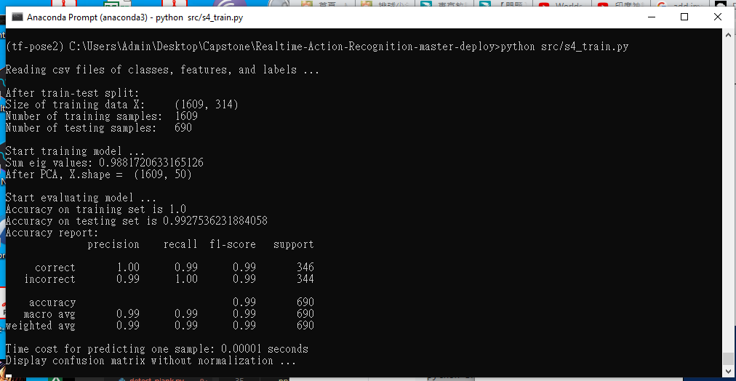
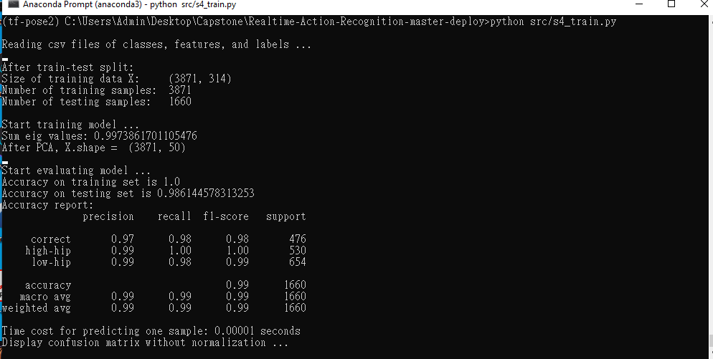
Action Recognition Models Accuracy
Plank
Squat
Notes:
And these are the accuracy for our action recognition models. We can see that both of them are close to a 100%.

Slide 14
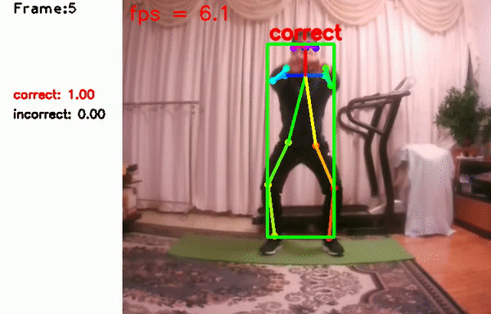
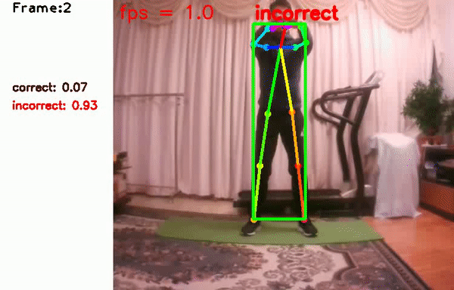
Action Recognition Demo: Squat
Notes:
Here, are the action recognition demonstrations for squat. On the left shows a correct squat, where the person starts with the feet wider than the hip-width and focus on turning the knees out when going down. On the right shows an incorrect squat, where the knees are turning inward.

Slide 15
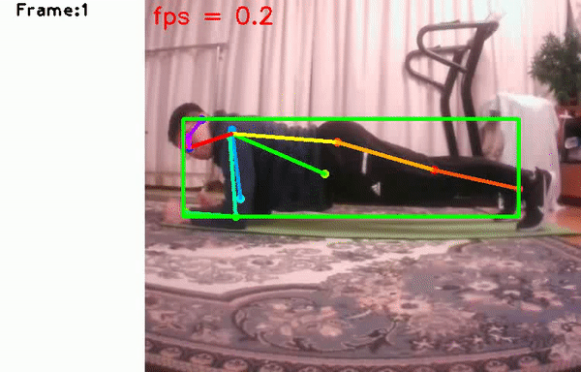
Action Recognition Demo: Plank
Notes:
And this is the demonstration for plank, it considers the form as incorrect when the hip is too low or too high.

Slide 16
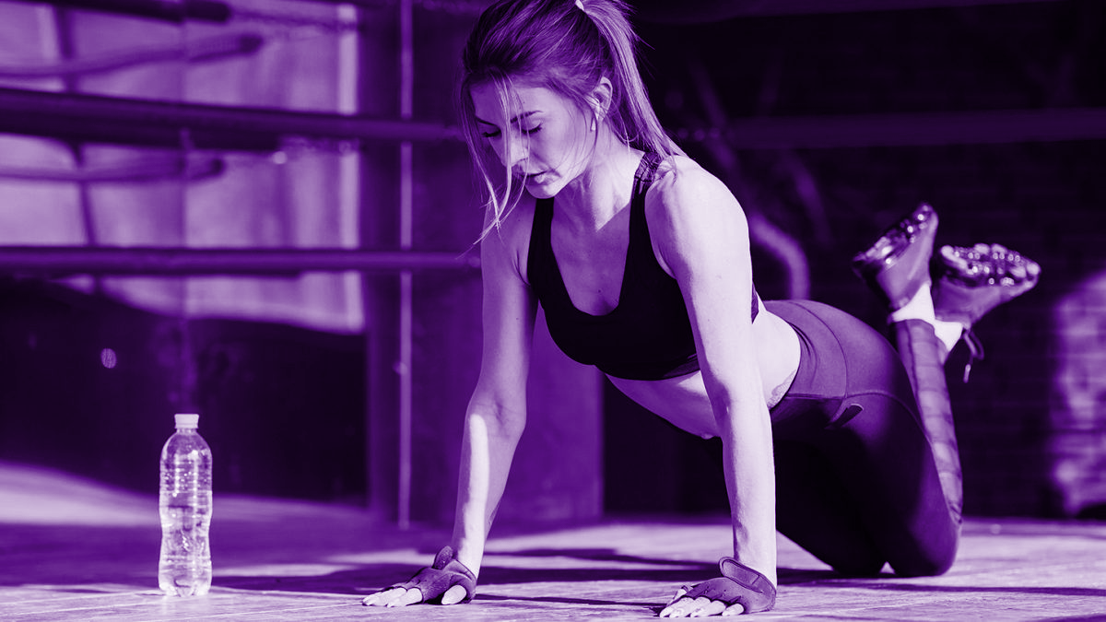
04
Counting Recognition Model

Slide 17
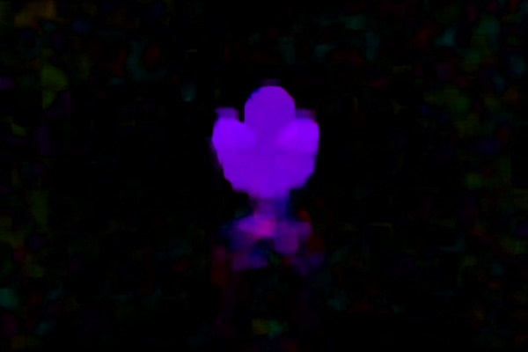
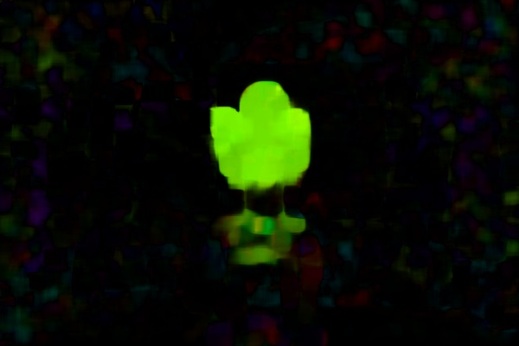
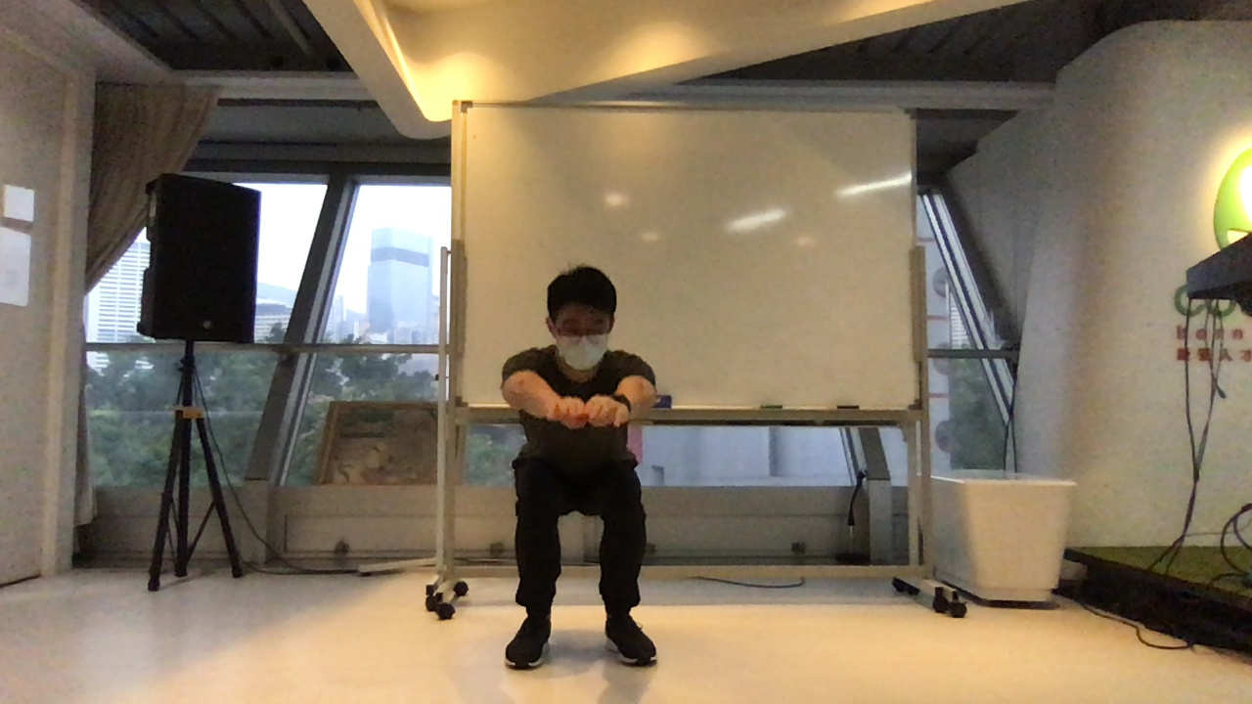
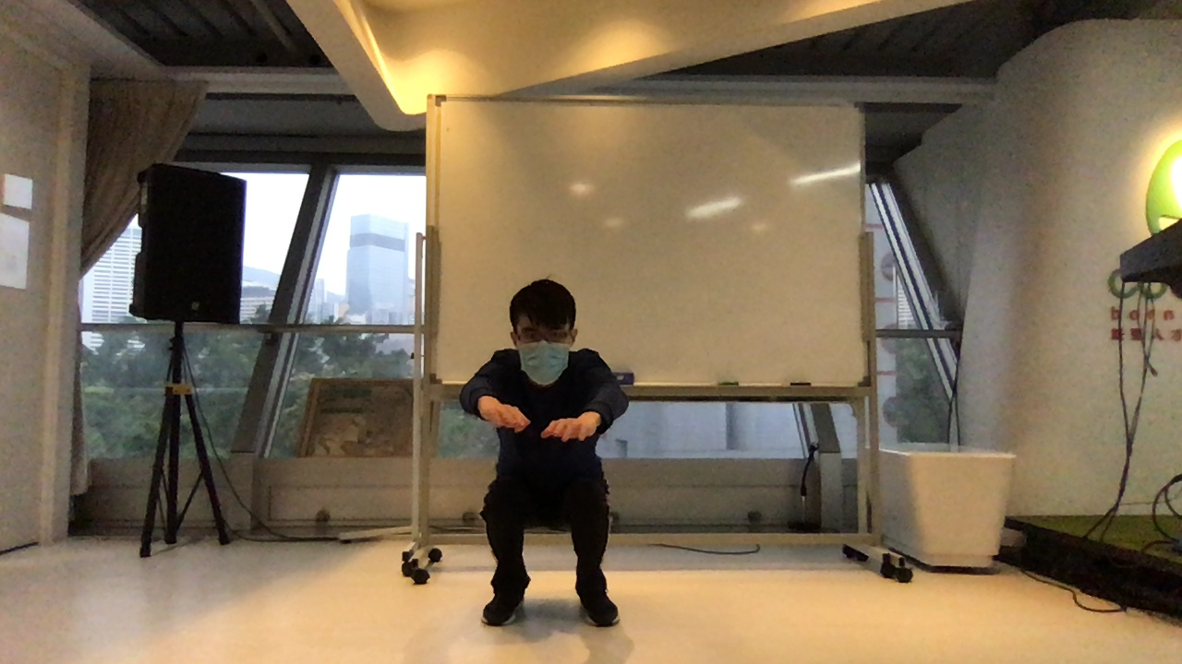
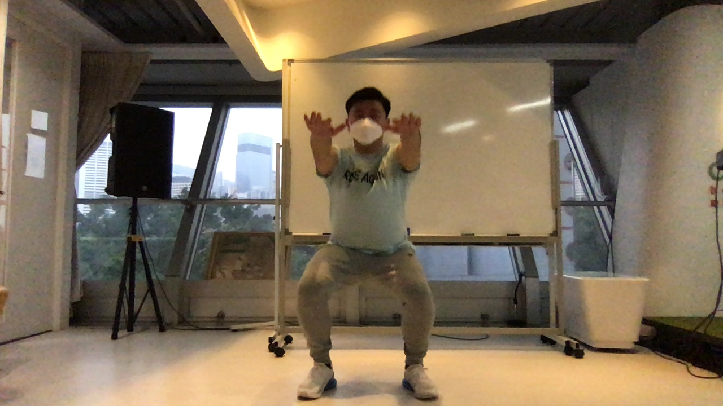
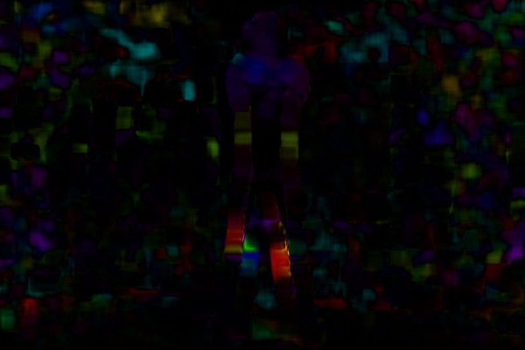
Data (Counting Detection Model)
594
Up
WHY???
Training image pre-processing
Squat
Optical flow algorithm
Down
764
Static
819
Notes:
-optical flow algo
-why (optical flow)

Slide 18
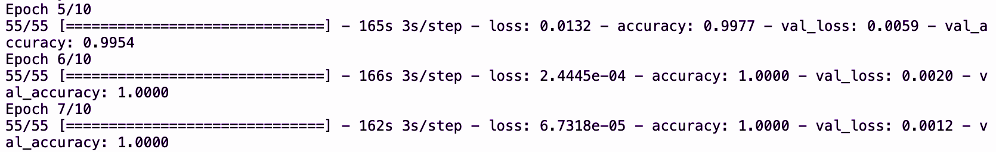
flatten
Up
Down
Static
Conv2d (relu function)
Conv2d (relu function)
Dense (softmax function)
32 layers
64 layers
Dense (relu function)
3 output layers
10 layers
Accuracy: 100%
Notes:
-After made,

Slide 19
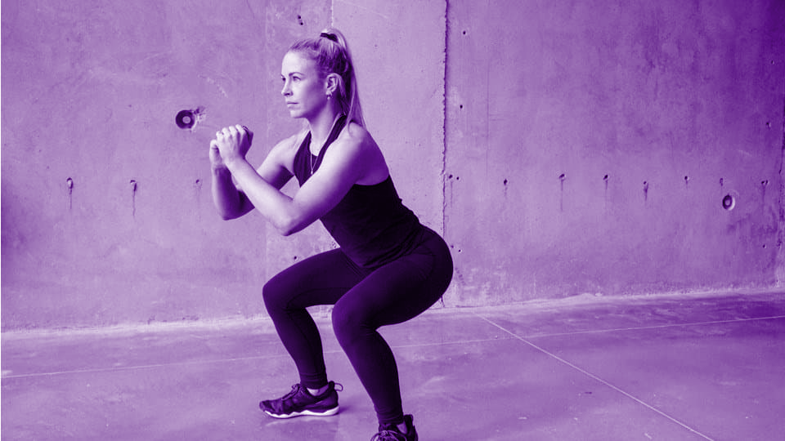
05
Deployment

Slide 20
Deployment
Flask, HTML, CSS
3 webpages
Index Page
Squat Page/ Plank Page
Squat Result Page/ Plank Result Page
Index Page
Choose Squat
Choose Plank
Submit Number of Squats
Submit Duration of Plank
Squat Page
Plank Page
Show Result
Show Result
Squat Result Page
Plank Result Page
Notes:
And for the deployment, we used flask to deploy the python app to html and used css to design the webpage. The users will see three webpages, the index page where the users can select whether he wants to do squat or plank. Once the user made the decision, he will see the squat or plank page. He will then either submit the number of squats or the duration of plank, then the webcam will start recording the video and the the workout detection will begin after 3 seconds. After finishing the workout, the user can then click the show result button and go to the result page, where he can see the result of his workout, and the videos for him to review why he had performed the exercise correctly or incorrectly.

Slide 21
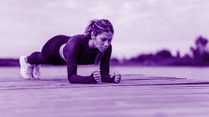
06
Demo

Slide 22

Deployment Demo: Squat
Notes:
This is the demonstration for the deployment of squat. This is the index page, in which the user can select whether he wants to do squat or plank. Here, we selected squat. Then, the user will come to the squat page, he can input the number of squat he wants to do. Here, we input 5. Once the user clicks the start button, the webcam and the workout detection model will start loading. Once the webcam starts recording, the workout detection will begin after 3 seconds. Here, I did 3 correct squats and 2 incorrect squats. After i performed each squat, the total count will increase by 1, and the correct or incorrect squat will increase as well. After doing 5 squats, the programme will stop and print finished on the screen, the user can then click the show result button and move to the result page. On the result page, the user can know his overall score, meaning how many squats he has performed correctly, and review each of his squat by watching the videos, the correct squats are shown on the left, and incorrect on the right.

Slide 23
Deployment Demo: Plank
Notes:
And this is the demonstration for the deployment of plank. Similarly, the user can input the duration of plank he wants to do, here we input 15 seconds. The webpage will show correct, when the user is doing the plank correctly, otherwise show low hip detected or high hip detected. Once 15 seconds have passed, the programme will print finished on the screen and the user can go to the result page.On the result page, the user can also see the percentage of correctness, and review the video to see why he has done the plank incorrectly.

Slide 24
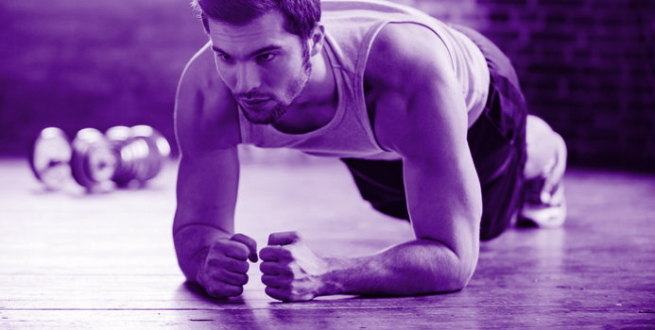
07
Challenges & Further Improvement

Slide 25
Challenges
Hardware restriction- require GPU to run the model
Deployment- the use of client’s webcam restricted from using webapp modules and deploying on GCP
Machine learning process- sensitive to the angle of the sample data
Limited identification of incorrect form

Slide 26
Further Improvements
More Mobile- mobile app and mobile responsive frontend
Types of exercise- include the detections for more types of exercise, like push-up, sit-up, etc.
Camera angle- enable an “all-perspective” operation
Correct skeleton- superimpose a correct skeleton on the image to show what was incorrect actually

Slide 27
Reference
An overview of human pose estimation with deep learning
https://medium.com/beyondminds/an-overview-of-human-pose-estimation-with-deep-learning-d49eb656739b
Detecting poses with openpose in googlecolab
https://blog.etereo.io/detecting-poses-with-openpose-in-google-colab-d591dc8d8609
Exercise classification with machine learning (part II)
https://towardsdatascience.com/exercise-classification-with-machine-learning-part-ii-d60d1928f31d
How I created the workout movement counting app using deep learning and optical flow algorithm
https://towardsdatascience.com/how-i-created-the-workout-movement-counting-app-using-deep-learning-and-optical-flow-89f9d2e087ac
Human Pose Detection
https://colab.research.google.com/drive/1CWNzP4ObgGersHu2KaVcNxUluqVo3nNp?usp=sharing
Introduction to Motion Estimation with optical flow
https://nanonets.com/blog/optical-flow/
Just used machine learning in my workout!
https://towardsdatascience.com/just-used-machine-learning-in-my-workout-ff079b8e1939
Pose estimation for fitness and physical therapy application
https://indatalabs.com/resources/human-activity-recognition-fitness-app
Realtime multiple person 2d pose estimation using tensorflow 2.x
https://towardsdatascience.com/realtime-multiple-person-2d-pose-estimation-using-tensorflow2-x-93e4c156d45f
Real-time human pose estimation in the browser with tensorflow.js
https://medium.com/tensorflow/real-time-human-pose-estimation-in-the-browser-with-tensorflow-js-7dd0bc881cd5
Used again machine learning in my workout, this time building a personal trainer
https://towardsdatascience.com/used-again-machine-learning-in-my-workout-this-time-building-a-personal-trainer-3dfae9730c2b
Video Streaming in Web Browsers with OpenCV & Flask
https://towardsdatascience.com/video-streaming-in-web-browsers-with-opencv-flask-93a38846fe00
3D openpose estimation in ai fitness coach apps
https://mobidev.biz/blog/human-pose-estimation-ai-personal-fitness-coach
human-pose-estimation-benchmarking-and-action-recognition
https://github.com/ChengeYang/Human-Pose-Estimation-Benchmarking-and-Action-Recognition
human -pose -estimation -opencv
https://github.com/quanhua92/human-pose-estimation-opencv
openpose
https://github.com/CMU-Perceptual-Computing-Lab/openpose
Realtime-action-recognition
https://github.com/felixchenfy/Realtime-Action-Recognition
tf-pose-estimation
https://github.com/ildoonet/tf-pose-estimation
video_streaming_with_flask_example
https://github.com/log0/video_streaming_with_flask_example
workout-evaluation-tf-openpose
https://github.com/MayankGupta73/Workout-Evaluation-tf-openpose

Slide 28
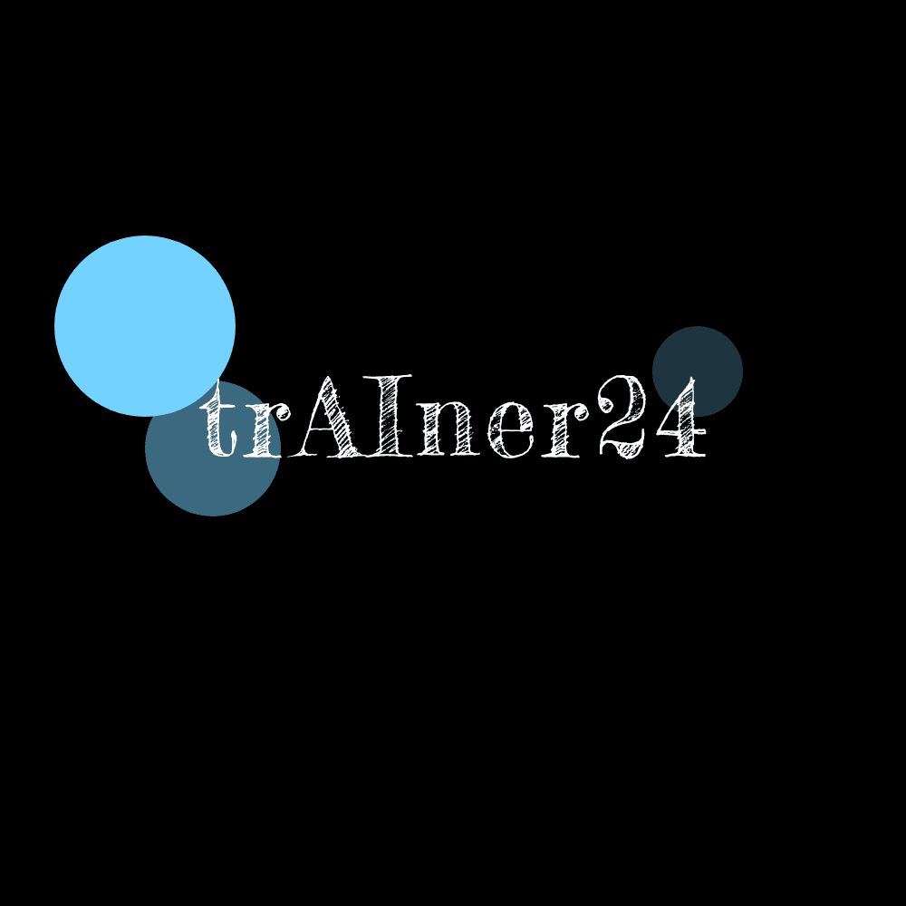
THANKS
Does anyone have any questions?

